Slide 1
Hyperparameters
Lecture IV
Alexei Prokudin
PHYS496

Slide 2
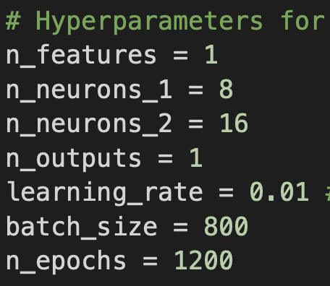
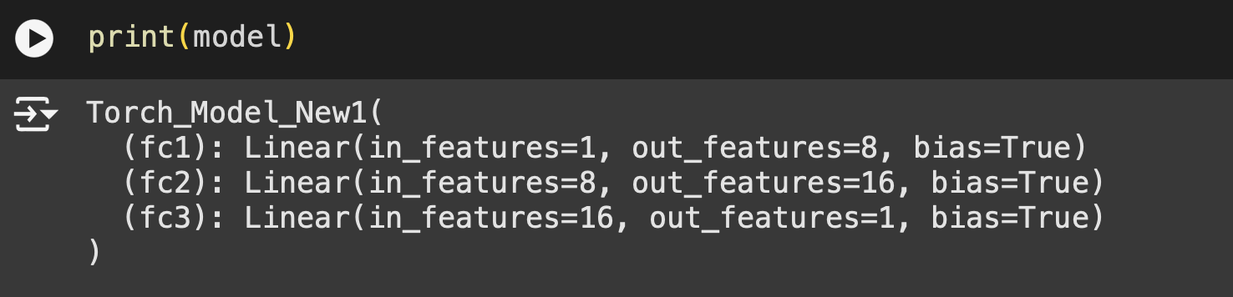
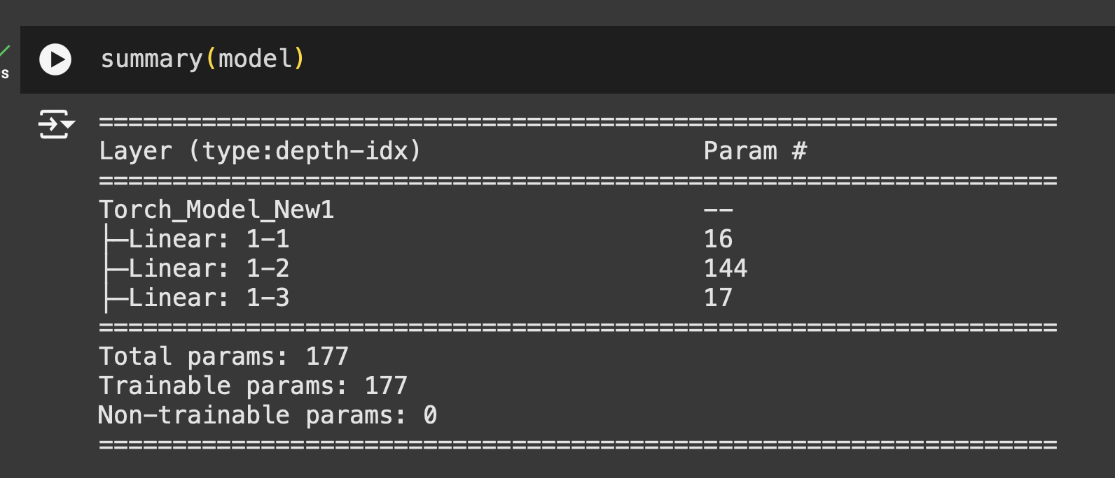
THE MODEL
Let us consider the following model and the following set of hyperparameters

Slide 3
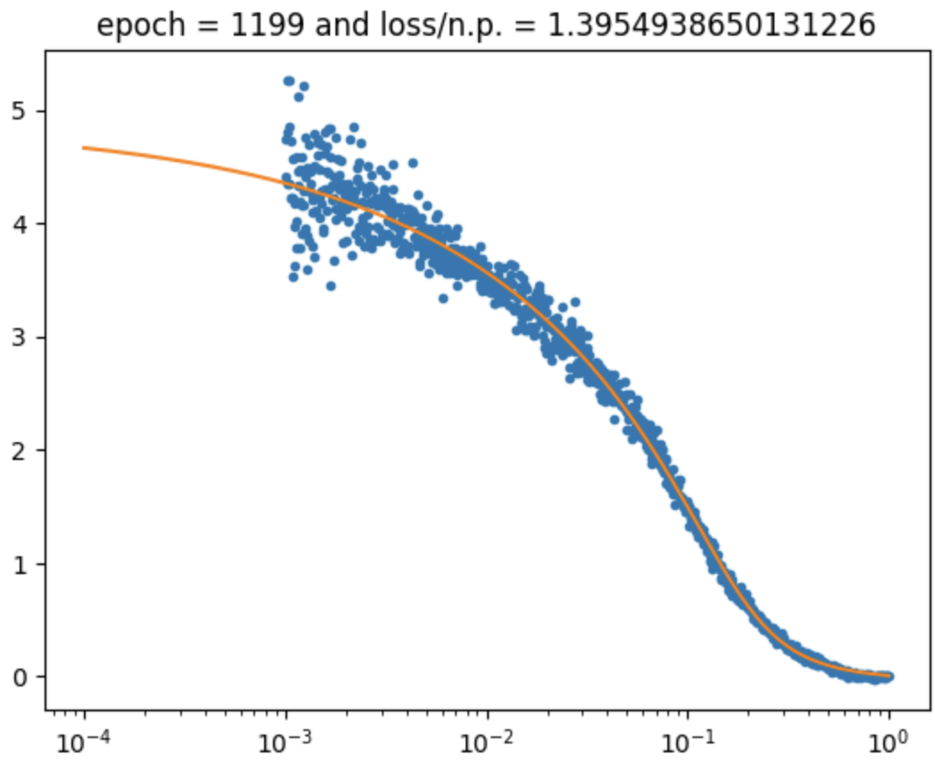
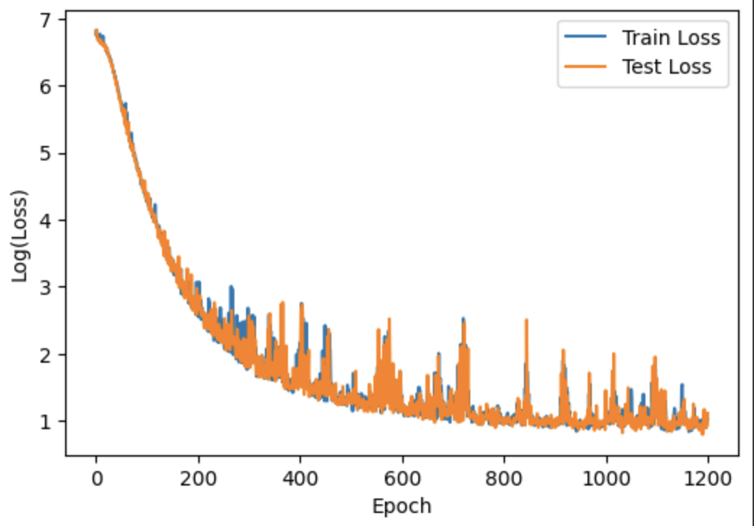
RESULTS

Slide 4
RESULTS
Notice that the loss function is quite spiky.
A spiky or erratic loss function during training can indicate various issues in your neural network's configuration, data, or optimization process. Here are some possible causes:
1. Learning Rate Issues
High Learning Rate: A learning rate that's too high can cause the optimizer to overshoot the minima, leading to instability in the loss function.
Learning Rate Scheduler: If a scheduler is poorly configured, it might cause abrupt changes in the learning rate during training.
2. Batch Size
Small Batch Size: Smaller batches increase the variance of the gradient updates, causing fluctuations in the loss.
3. Model Architecture
A model that's too complex (e.g., with too many layers or neurons) may overfit or struggle with certain data samples, leading to erratic loss behavior.
https://arxiv.org/pdf/2305.12133
https://arxiv.org/pdf/1802.08770

Slide 5
RESULTS
Possible Solutions
Tune the learning rate: Use a learning rate finder or gradual warm-up.
Use a learning rate scheduler: Gradually decay the learning rate.
Increase batch size: Try larger batch sizes to stabilize gradient updates.
Clean data: Check for noisy or mislabeled data and preprocess it correctly.
Adjust regularization: Experiment with regularization strength.
Gradient clipping: Limit the gradient's magnitude to avoid spikes.
Smooth the loss: Plot a moving average of the loss to better visualize trends.
Inspect architecture and initialization: Ensure your model isn't overparameterized or initialized poorly.
https://arxiv.org/pdf/2305.12133
https://arxiv.org/pdf/1802.08770

Slide 6
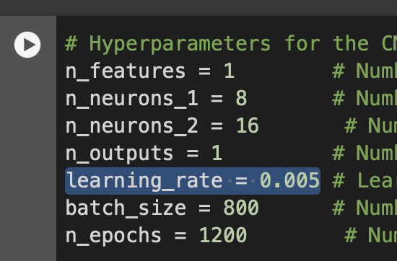
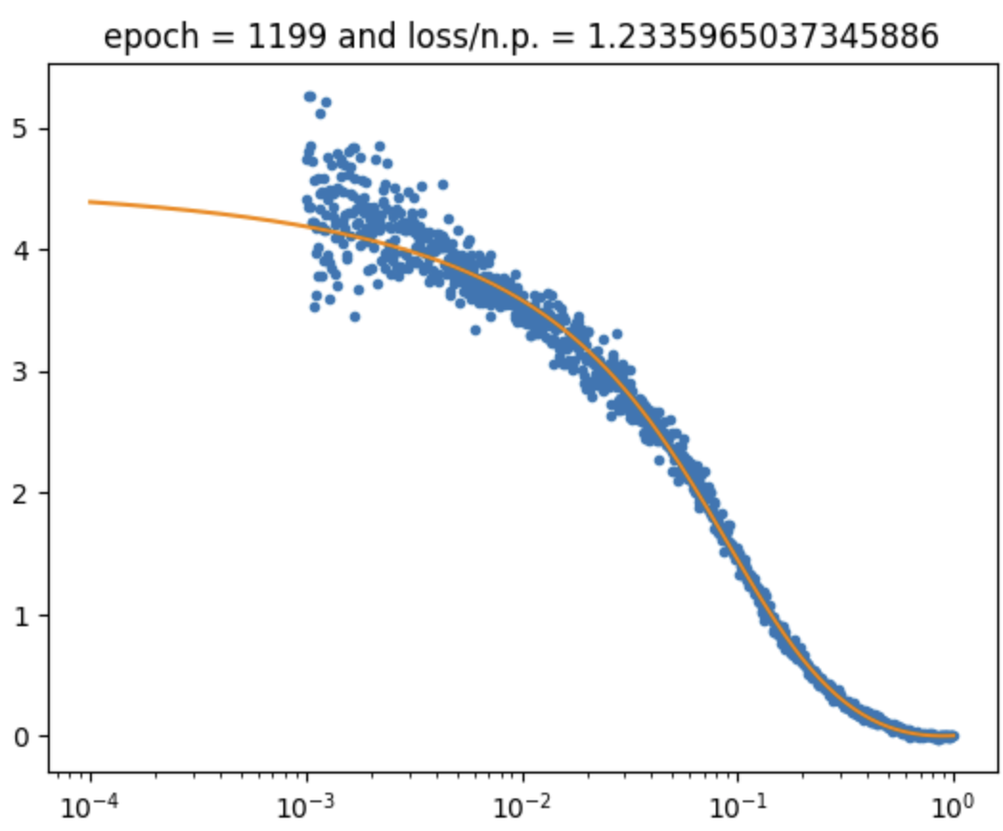
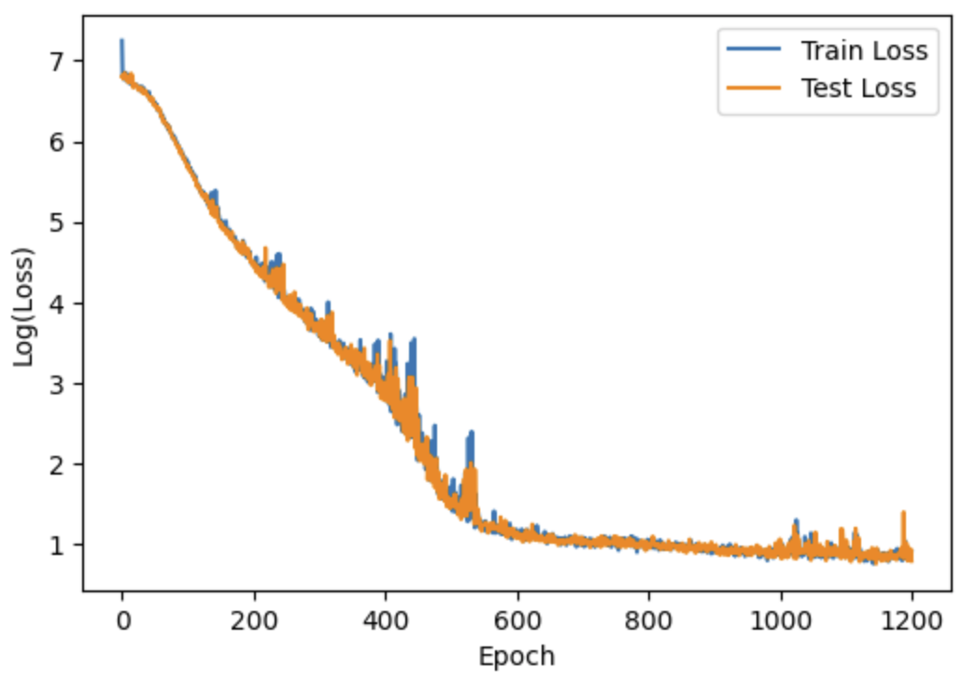
RESULTS
Possible Solutions
Tune the learning rate: Use a learning rate finder or gradual warm-up.

Slide 7
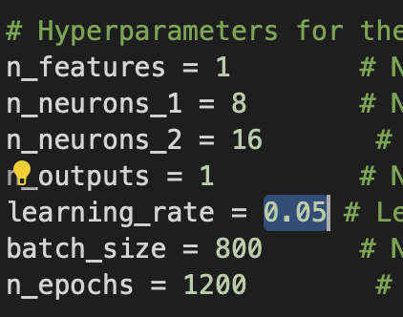
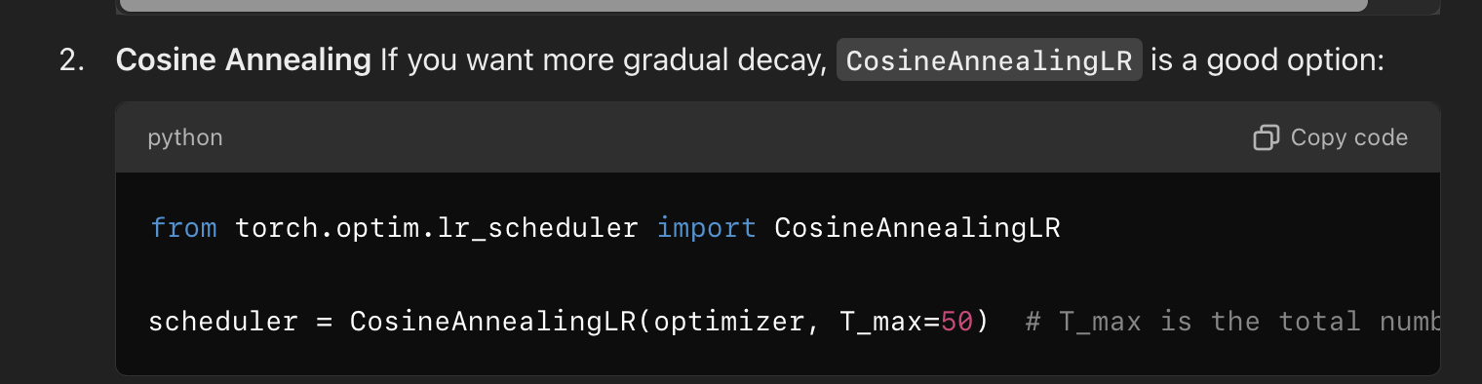
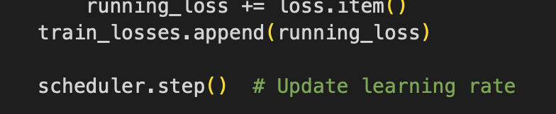
RESULTS
Possible Solutions
Use a learning rate scheduler: Gradually decay the learning rate.
Using a Learning Rate Scheduler PyTorch provides several schedulers to adjust the learning rate during training.

Slide 8
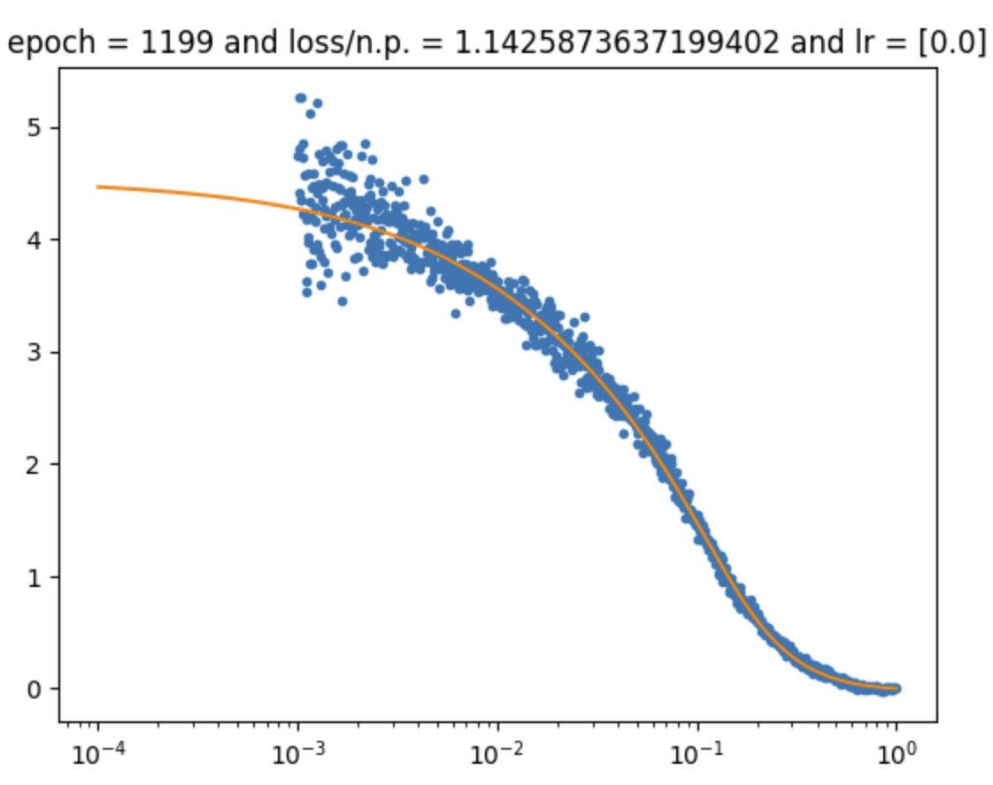
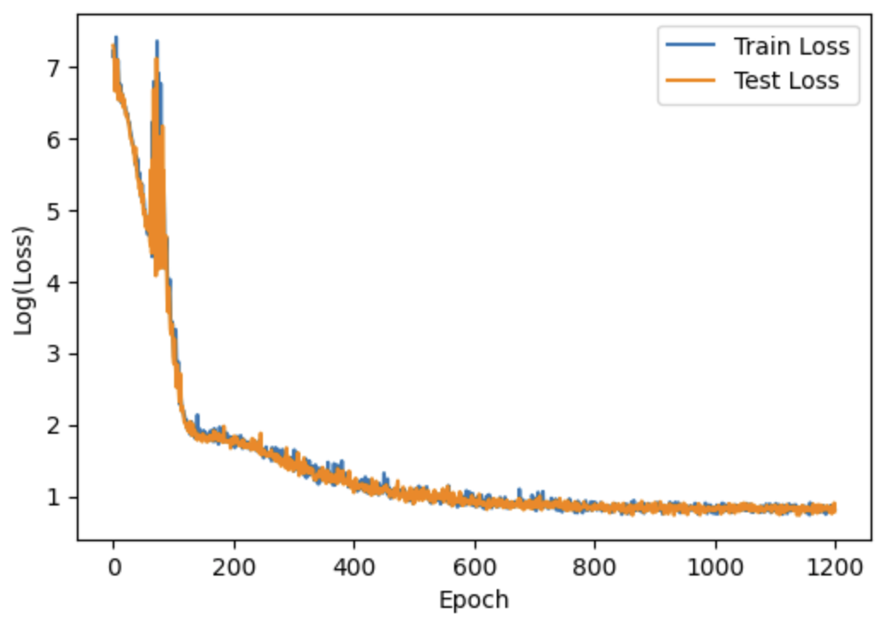
RESULTS
Possible Solutions
Use a learning rate scheduler: Gradually decay the learning rate.
Using a Learning Rate Scheduler PyTorch provides several schedulers to adjust the learning rate during training.

Slide 9
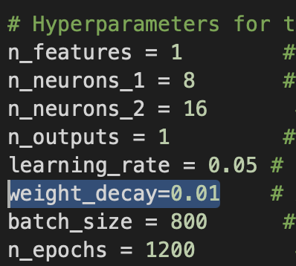

RESULTS
Possible Solutions
Adjust regularization: Experiment with regularization strength.
Adjusting regularization strength is an important step to control overfitting or underfitting in your model. Regularization adds a penalty to the loss function to discourage the model from fitting noise or over-complicating its parameters.
L2 Regularization (Ridge or Weight Decay)
Penalizes the squared values of the weights, discouraging large weight magnitudes.
Usually integrated into the optimizer via the weight_decay parameter.

Slide 10
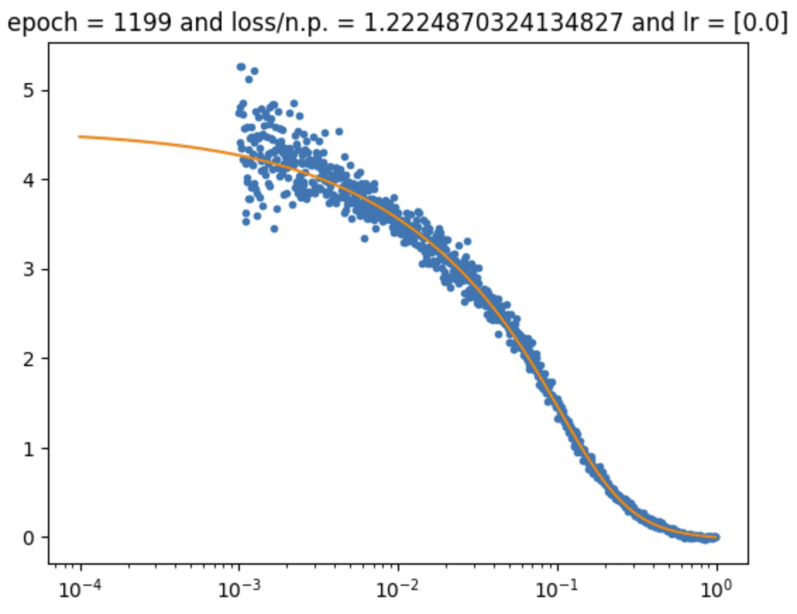
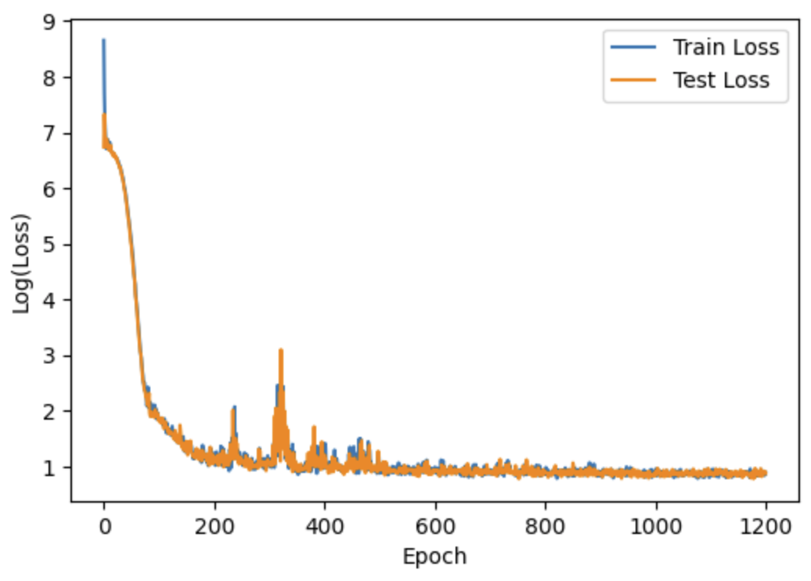
RESULTS
Possible Solutions
Adjust regularization: Experiment with regularization strength.

Slide 11
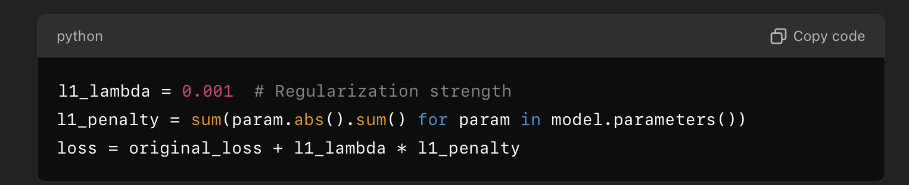
RESULTS
Possible Solutions
Adjust regularization: Experiment with regularization strength.
Controlling Regularization Strength
Start small: Begin with a small value for λ (e.g., 0.0001) and gradually increase until you find a good trade-off between underfitting and overfitting.
Monitor training and validation loss:
If training loss decreases sharply but validation loss increases, reduce regularization.
If training loss decreases very slowly, increase regularization strength.
L1 Regularization
Penalizes the absolute values of the weights, promoting sparsity (some weights are driven to zero).
Controlled by a regularization parameter λ (lambda).

Slide 12
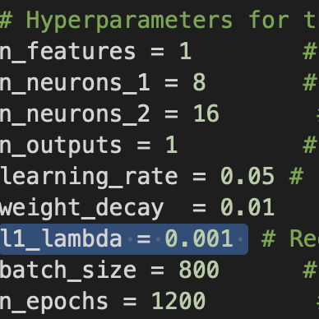

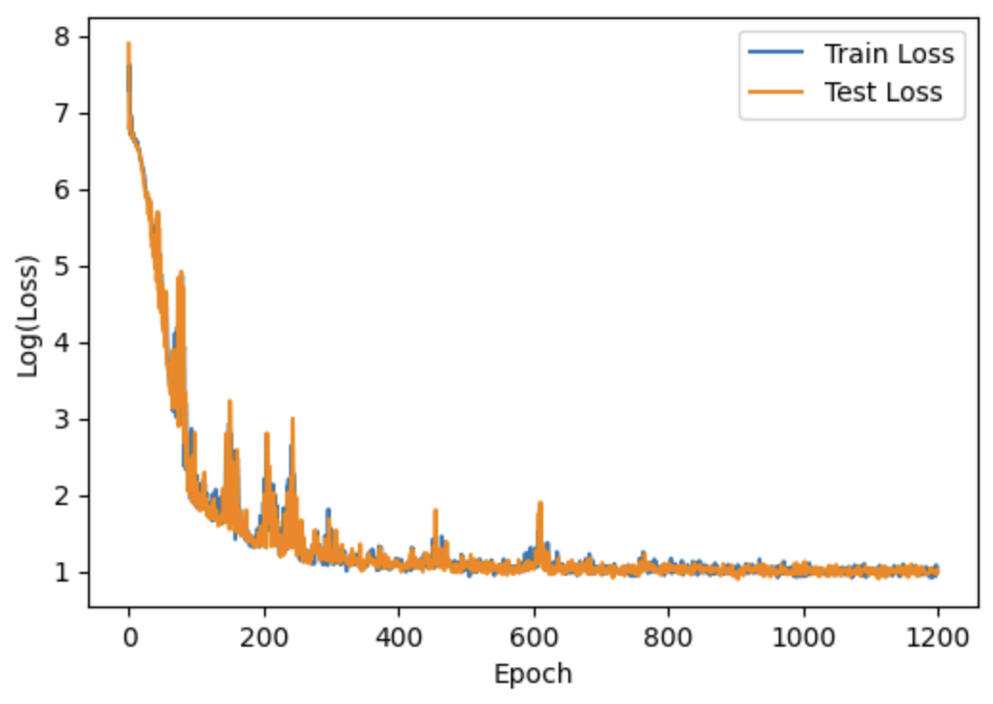
RESULTS
Possible Solutions
Adjust regularization: Experiment with regularization strength.

Slide 13
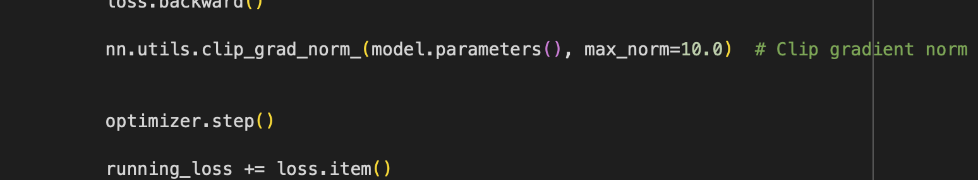
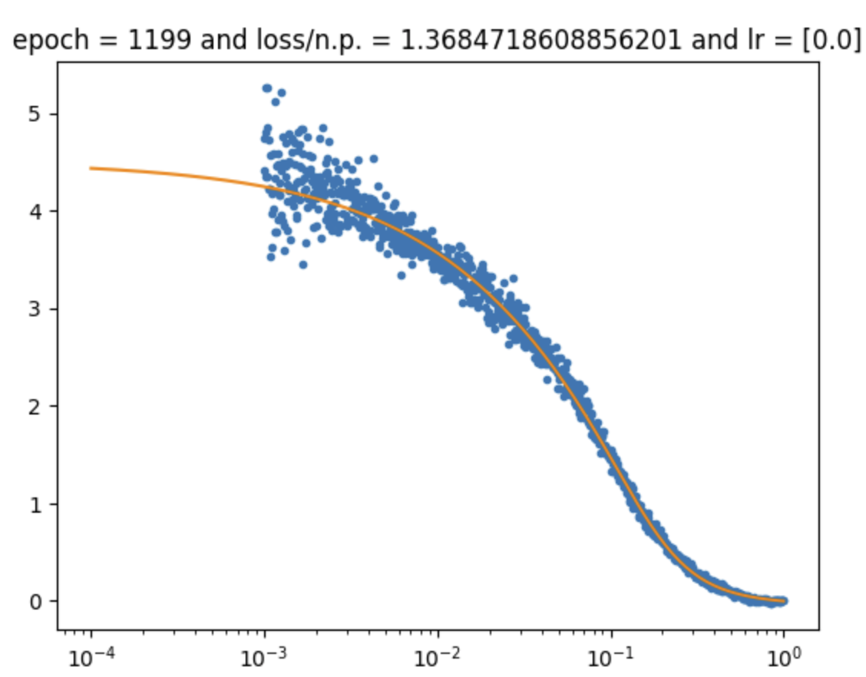
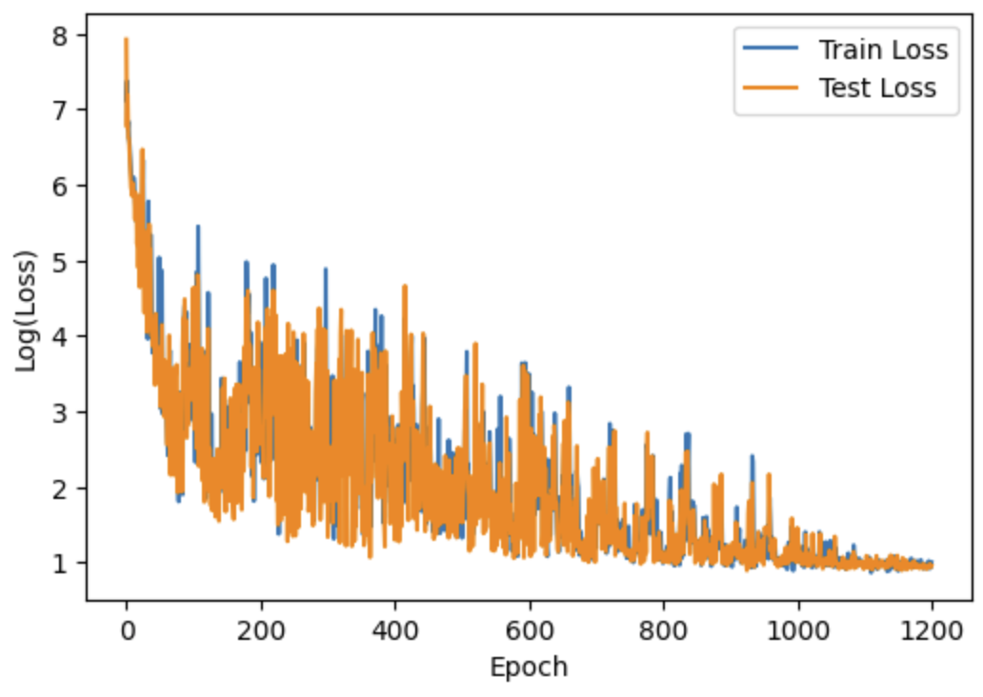
RESULTS
Possible Solutions
Gradient clipping: Limit the gradient's magnitude to avoid spikes.

Slide 14
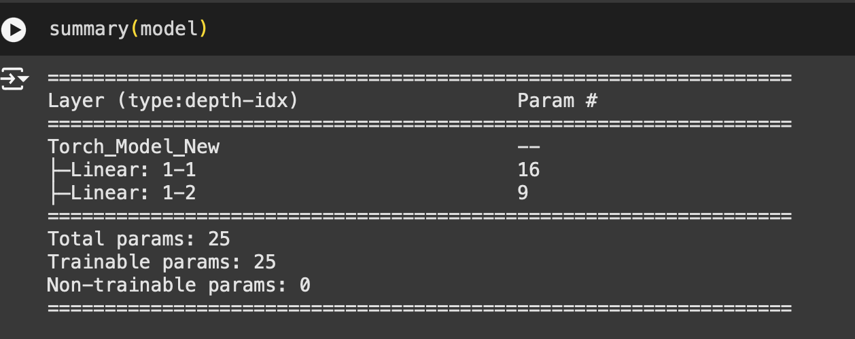
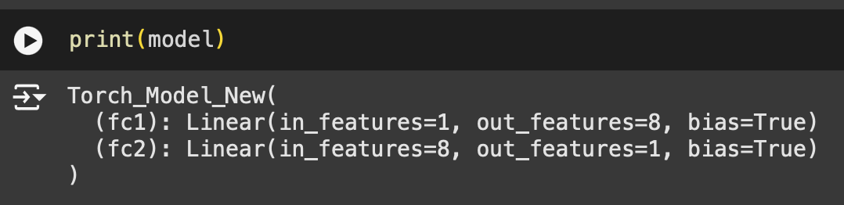
RESULTS
Possible Solutions
Inspect architecture and initialization: Ensure your model isn't overparameterized or initialized poorly.

Slide 15

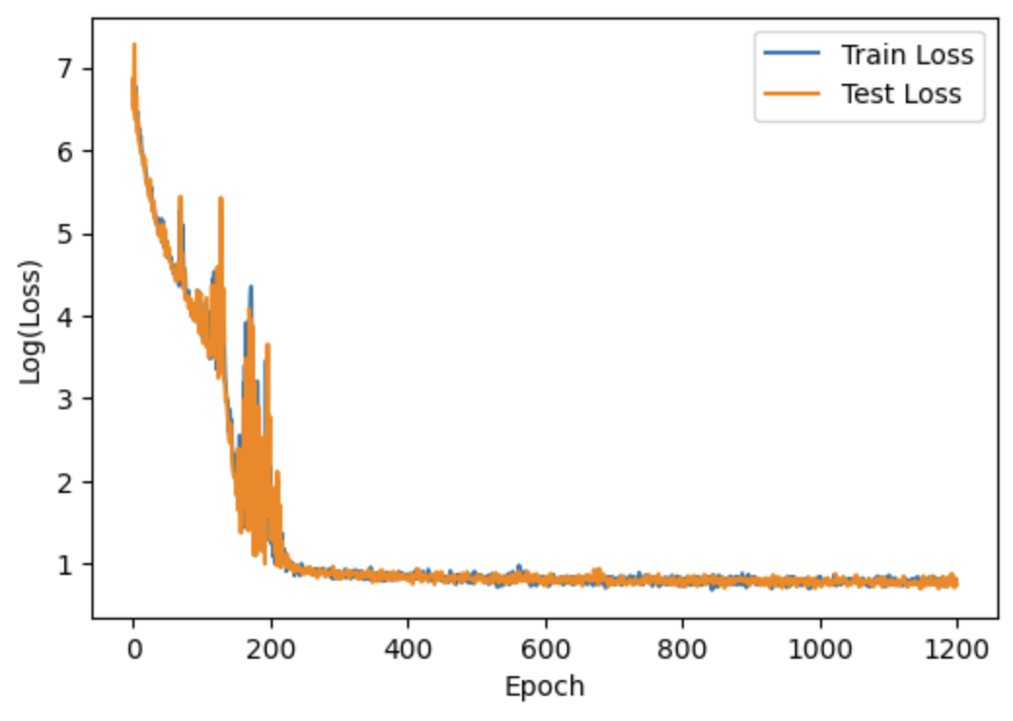
RESULTS
Possible Solutions
Inspect architecture and initialization: Ensure your model isn't overparameterized or initialized poorly.

Slide 16
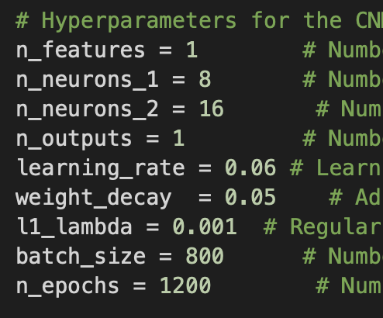

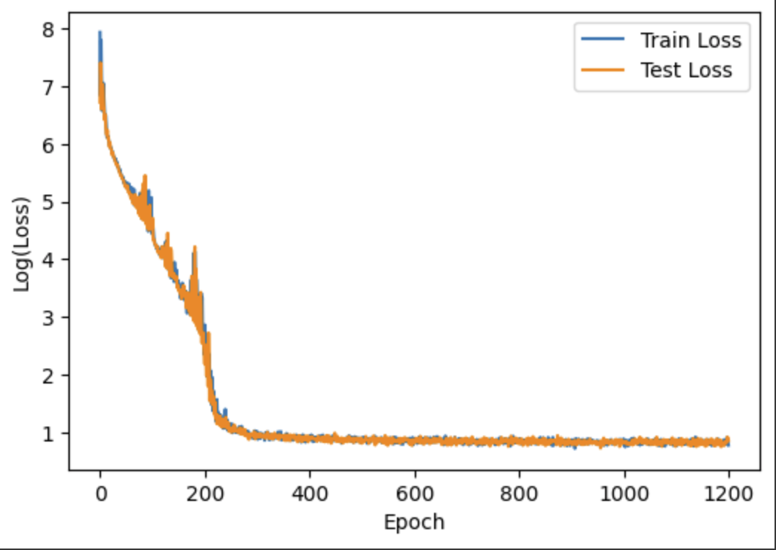
MY FINAL MODEL

Slide 17
WHAT IS YOURS?

